Slide 1
Event driven cloud computing
Team Member: Cory McAn
Product Owner: Jason Dettbarn of Addigy

Slide 2
Team Role
Developer, Tester, and Documentation Contributer
Backend functionality such as Lambda triggers on S3 buckets, concerned with efficiency of running multiple function instances

Slide 3
Importance
Addigy's project for Event Driven Cloud Computing provides:
A way for very in-depth system and security audits to be uploaded from client machines
Computation analysis to be performed on the data only when new data arrives
Messages IT Admins that manage clients in real-time that new data has been updated
No server needs to be maintained!

Slide 4
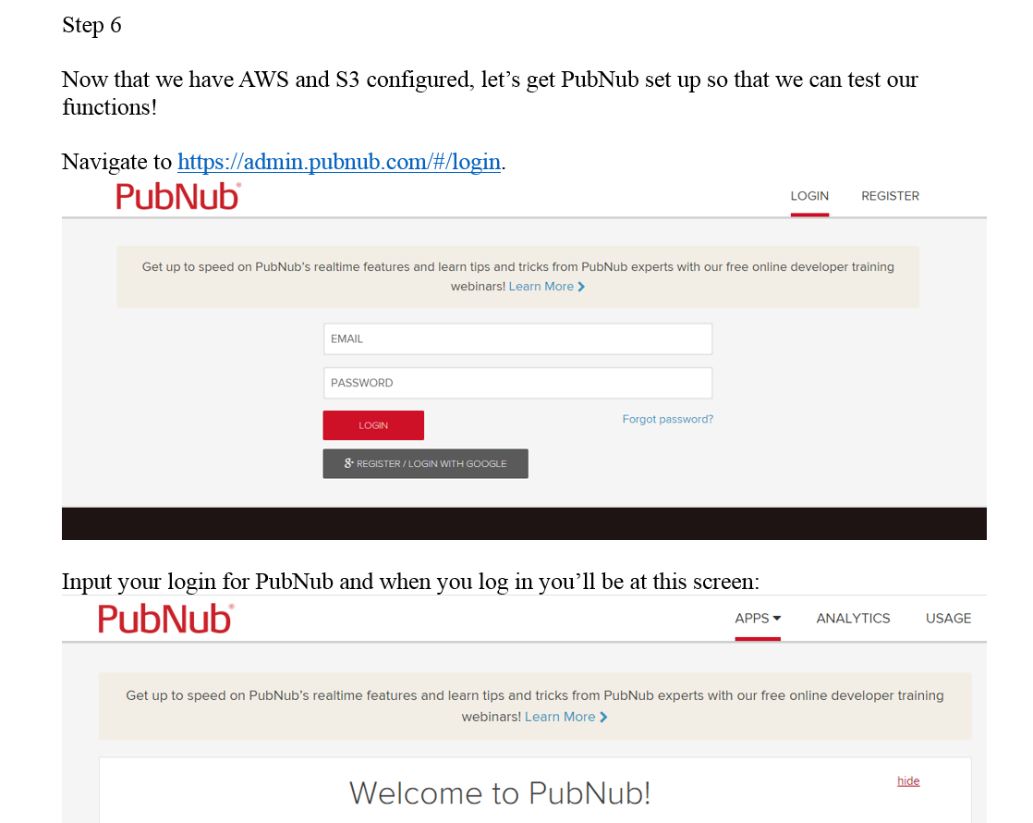
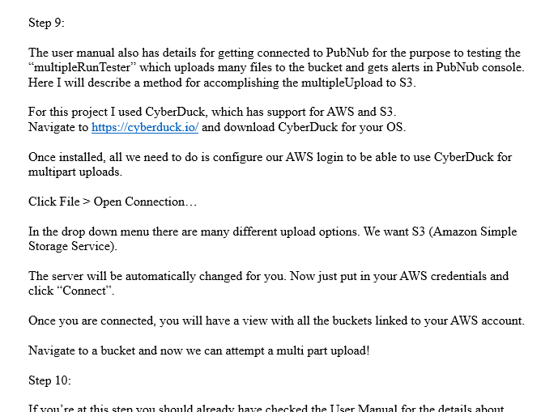
User manual Installation manual

Slide 5
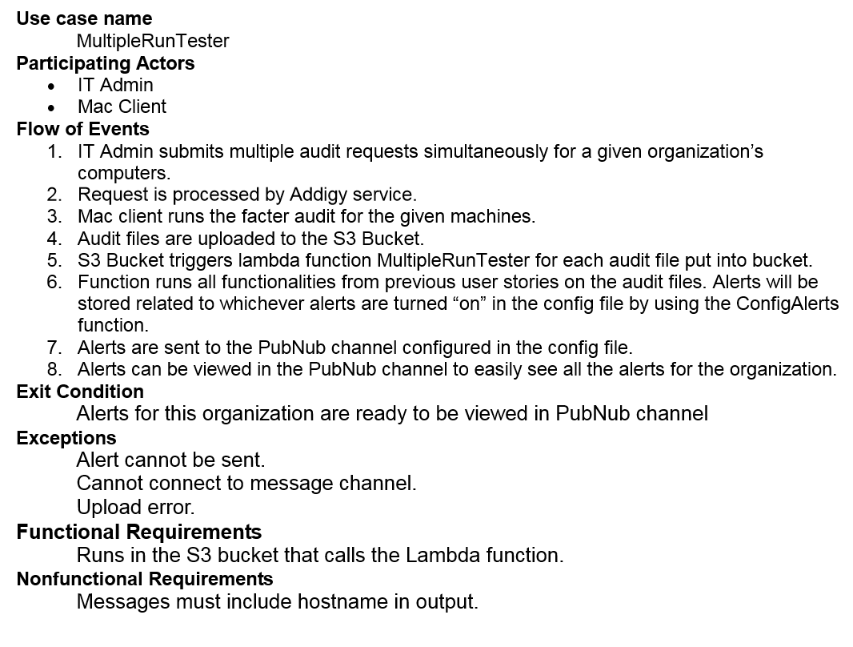
Use Cases

Slide 6
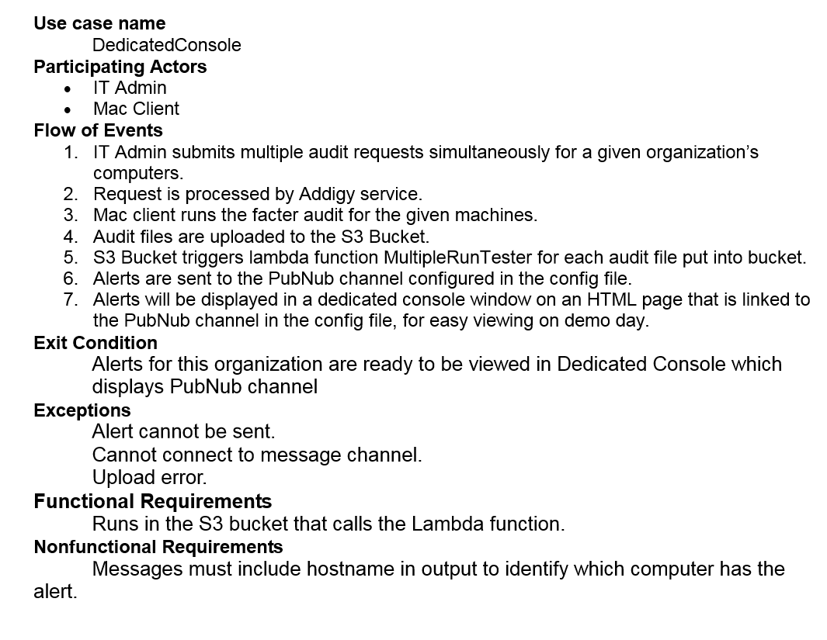
Use Cases

Slide 7
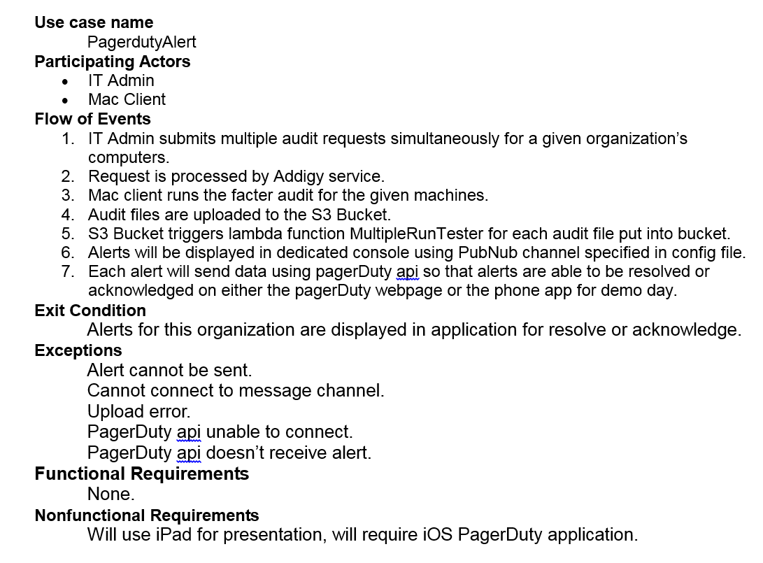
Use Cases

Slide 8
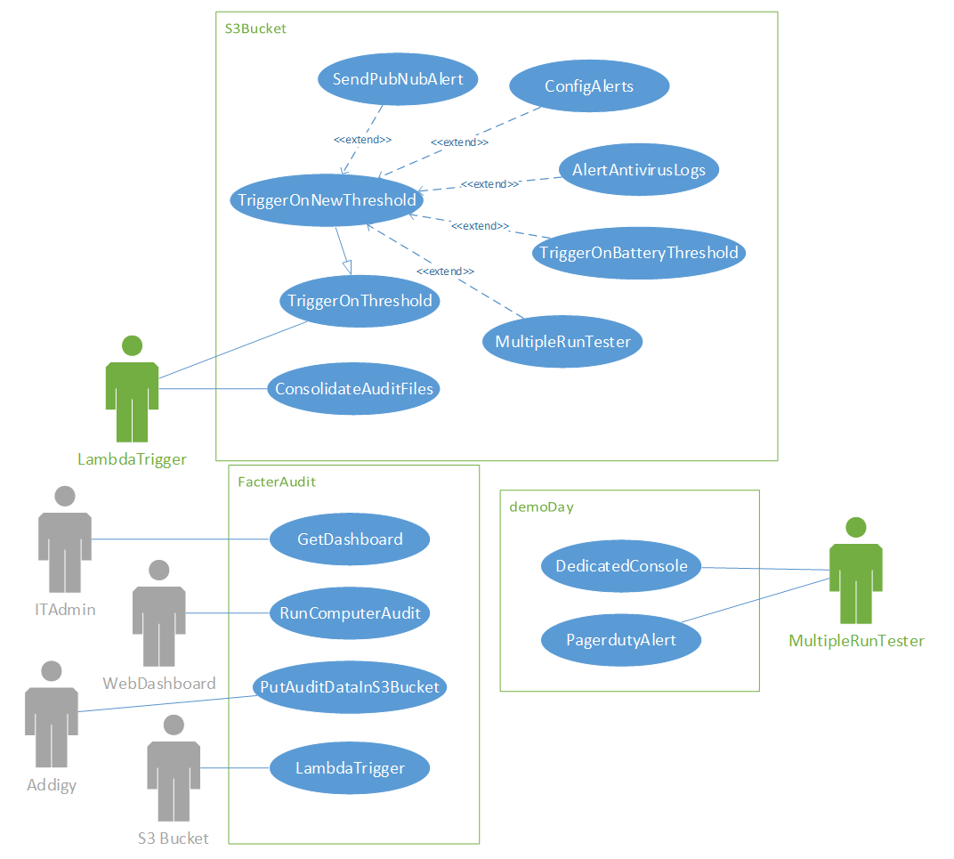
Use Case diagram

Slide 9
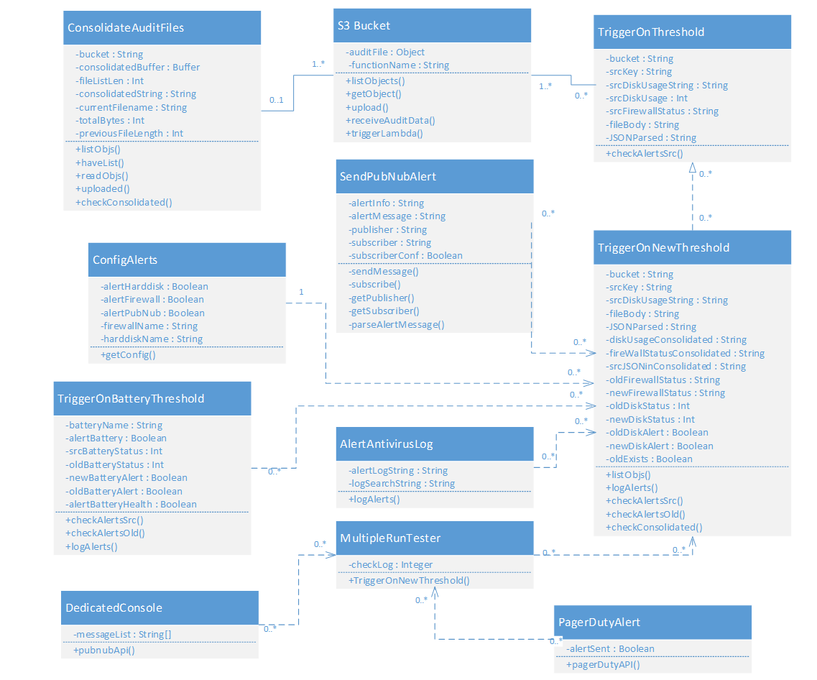
Class diagram

Slide 10
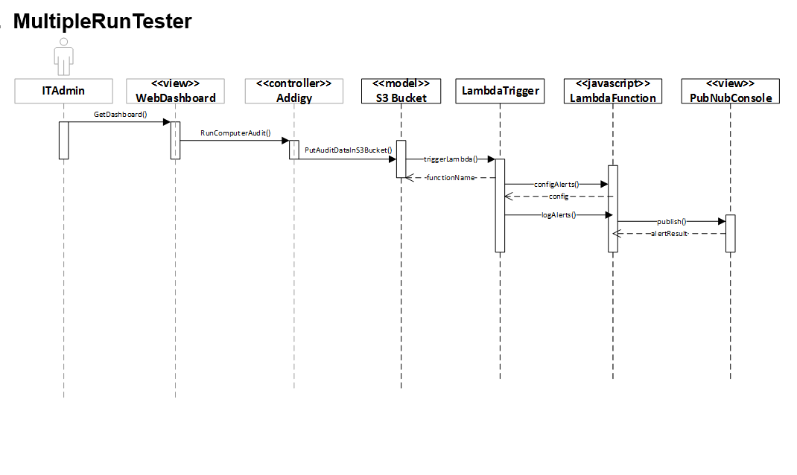
Sequence diagrams

Slide 11
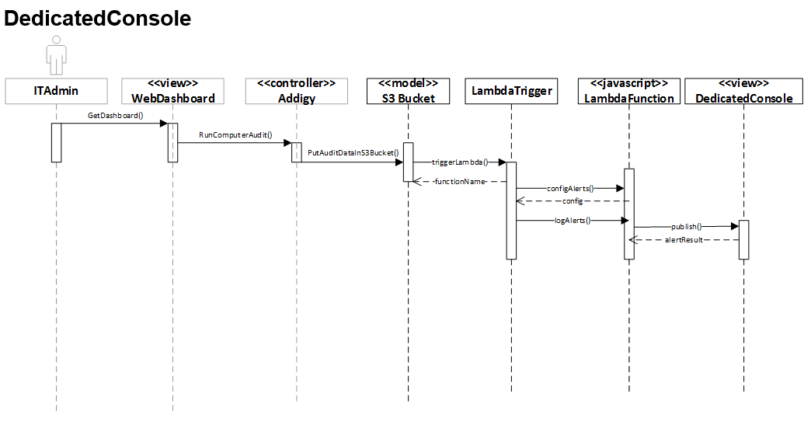
Sequence diagrams

Slide 12
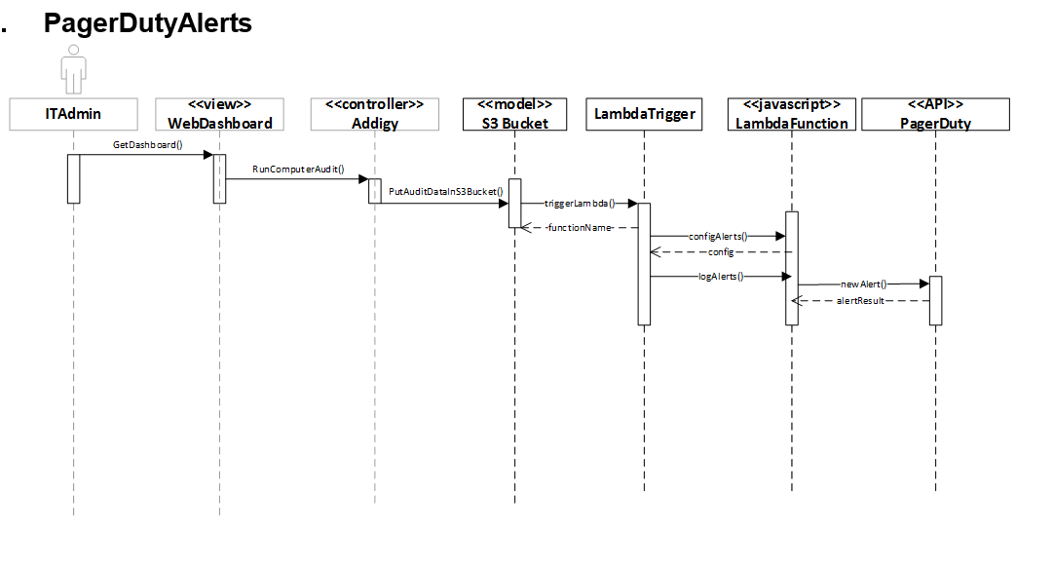
Sequence diagrams

Slide 13
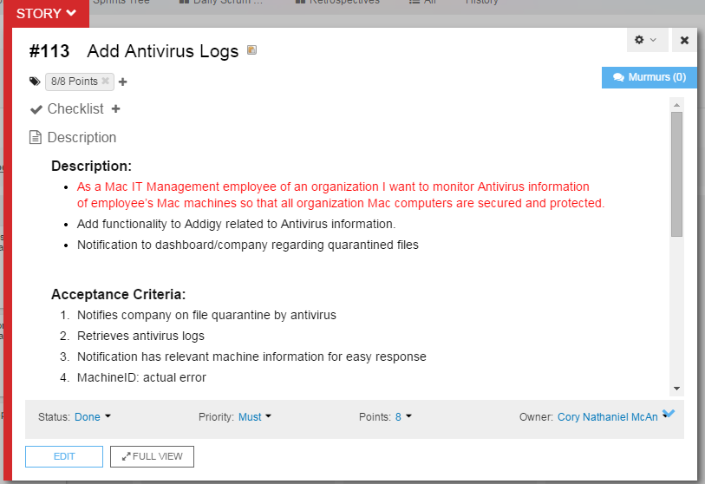
Sprint board: points

Slide 14
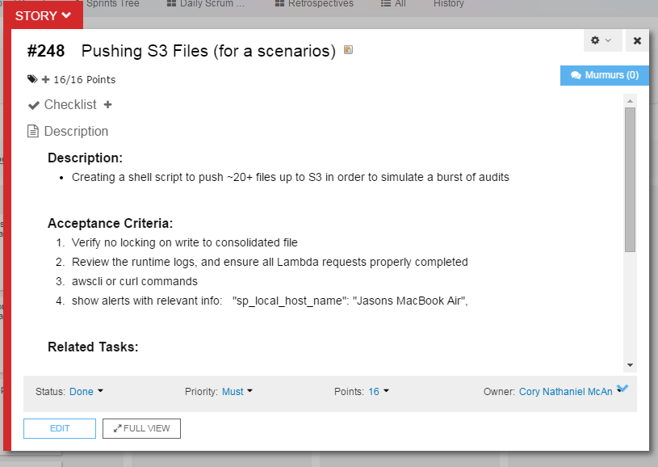
Sprint board: points

Slide 15
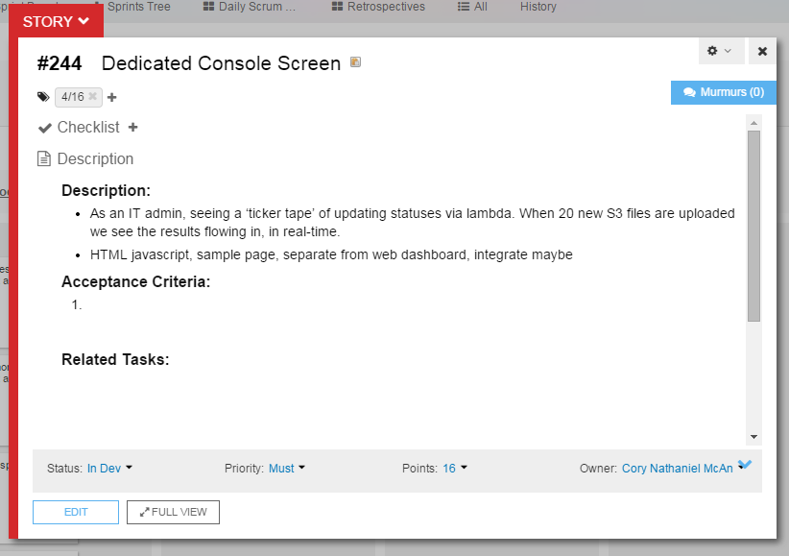
Sprint board: points

Slide 16
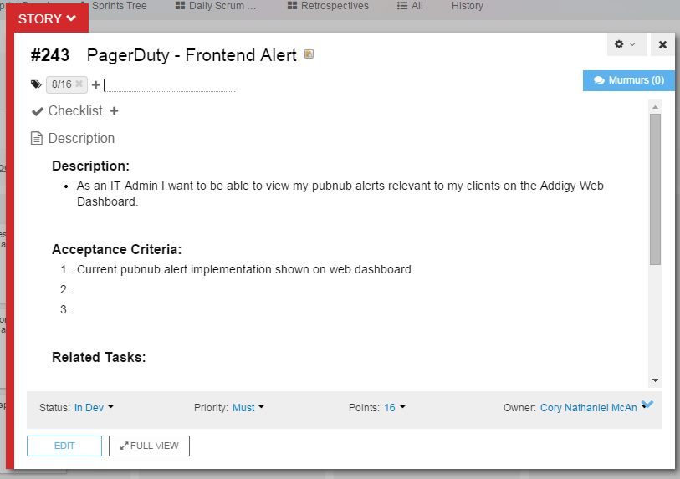
Sprint board: points

Slide 17
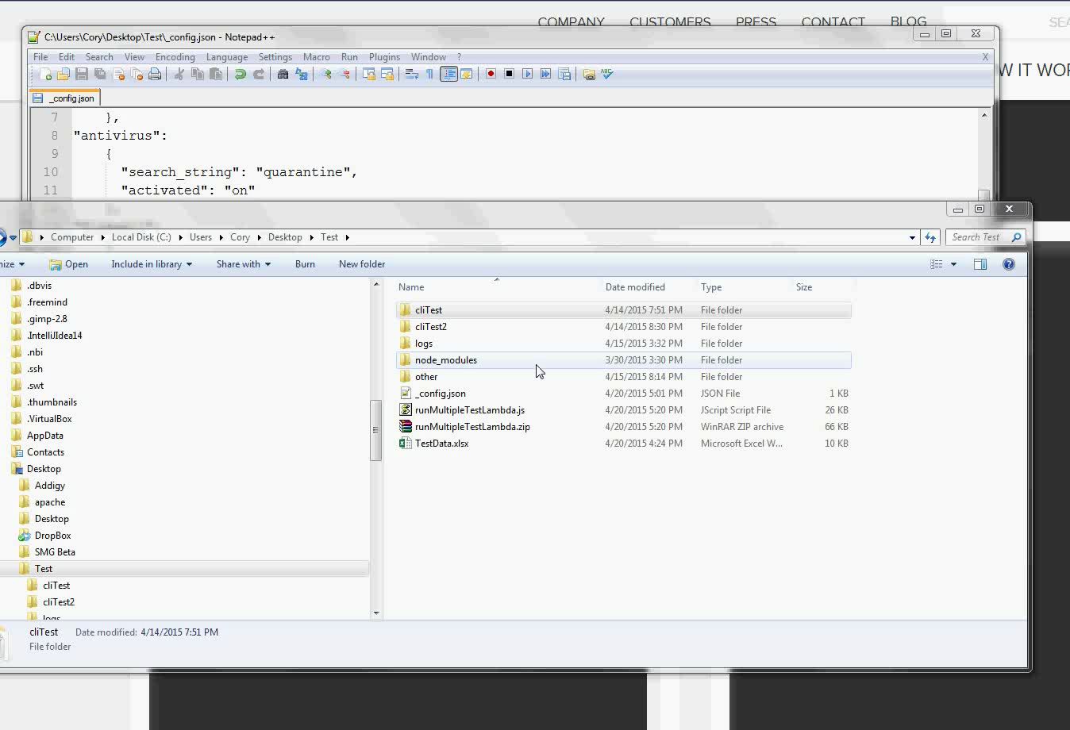
Demo

Slide 18
Scrums: Overview
Day 1 - 5:
Fix previous documentation.
add new documentation for first and second user story,
work on first user story, complete 1st user story.
Ask for approval on first user story, work on 2nd user story.
Continue work on 2nd user story.
Day 6 - 10:
Start 3rd and 4th user story documentation.
Continue 2nd user story, complete 2nd user story.
Start 3rd user story, running into issues. Met with Jason.
Start 4th user story research to prepare for integration with 3rd.
8 + 16 + 4 + 8 = 40 / 56 Points Completed!
Points:
Day 1: 4/8 1st User Story; Expect: 4, Complete: 4
Day 2: 8/8 1st User Story; Expect: 4, Complete: 4
Day 3: 4/16 2nd User Story; Expect: 4, Complete: 4
Day 4: 8/16 2nd User Story; Expect: 4, Complete: 4
Day 5: 12/16 2nd User Story; Expect: 4, Complete: 4
Day 6: 16/16 2nd User Story; Expect: 4, Complete: 4
Day 7: 4/16 3rd User Story; Expect: 4, Complete: 4
Day 8: 4/16 4th User Story ; Expect: 4, Complete: 4
Day 9: 6/16 4th User Story; Expect: 4, Complete: 2
Day 10: 8/16 4th User Story, Expect: 4, Complete: 2

Slide 19
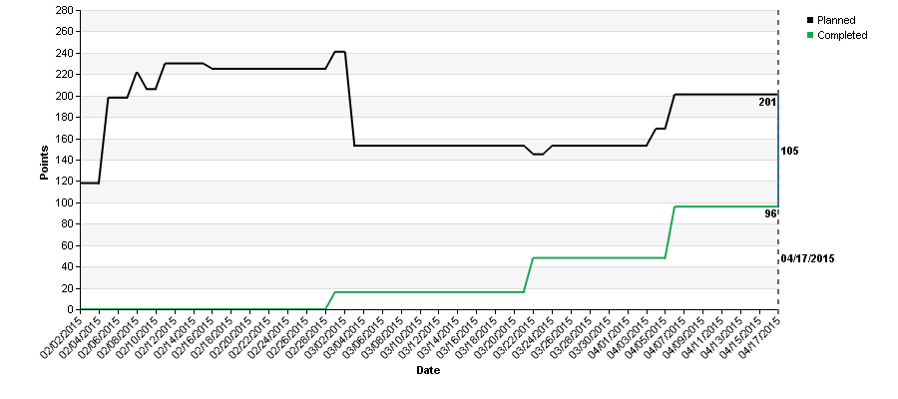
Burn up chart

Slide 20
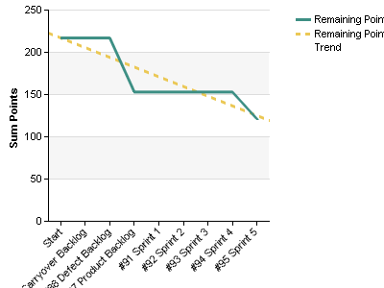
Burn down chart

Slide 21
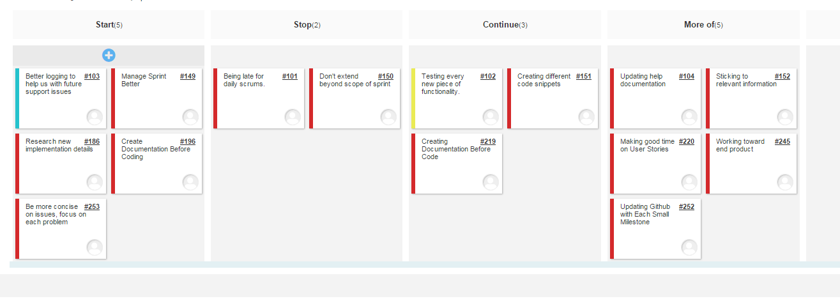
Retrospectives

Slide 22
Thank you for attendinG!

